Slide 1
Data structures Binary trees
13 May 2020

Slide 2
Data management
Essential functionalities
Store
Retrieve
Other characteristics
Fast
Scale well with size (O(log n))

Slide 3
Binary tree - definition
“A binary tree is either empty or it contains a root node and left- and right- subtrees that are also binary trees”

Slide 4
Basic terminology
A
ROOT NODE
B
C
D
E
F
G

Slide 5
Basic terminology
A
ROOT NODE
Left Child
Right Child
B
C
D
E
F
G

Slide 6
Basic terminology
A
ROOT NODE
Left Child
Right Child
B
C
Leaf Nodes
D
E
F
G

Slide 7
Unordered binary tree
+
Not many directly relevant applications for us
Used in graph theory etc.
/
*
1
21
4
9

Slide 8
assumption
Elements to be stores are ordered
i.e. can be compared with a < operator
Numbers – ordered
Strings – ordered (lexicographical)

Slide 9
Binary search tree - ordered
A rooted tree with
At most 2 children
An element stored at each vertex
“Search” property / Ordering
For every vertex V
Elements in V’s left subtree are smaller than V
Elements in V’s right subtree are larger than V
PAY ATTENTION TO THE RECURSIVE DEFINITION

Slide 10
Why?
We need a fast way of storing sets with the following operations
Find
Insert
(Think about various places where this may be applied)

Slide 11
Solutions we know so far include
Unsorted array
Sorted array
Heap/Priority queue
All of these take O(n) for insertion and find
Binary tree – O(log(N))*
* - On an average

Slide 12
Implementation – Node object
Attributes
Left (for left subtree)
Right (for right subtree)
Data – datapoint of that node
The leaf nodes have left and right as none

Slide 13
Algorithm - find
Objective – return true if an element is present in the set
Algorithm
If mynode.data == None: Return false
if mynode.data == x: Return true
if Mynode.data >= x: Return find(Mynode.left, x)
Else return find(Mynode.right, x)

Slide 14
Algorithm insert
If data < self.data: self.left.insert(data)
Elif data > self.data: self.right.insert(data)
Else self.data = data

Slide 15
Time analysis - find
Every time find is invoked, we go down from parent to child.
Thus, O(find) ~ O(longest path)
Number of recursive calls = number of nodes visited

Slide 16
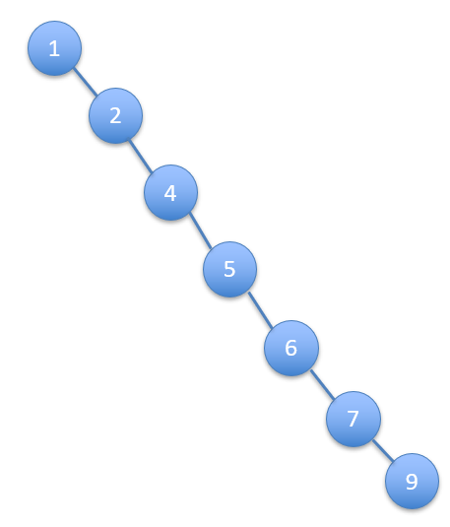
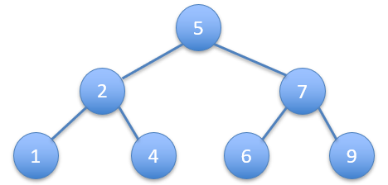
Time analysis - find
Best case – O(log(N))
Worst case – O(N)
Analysis for insert - similar

Slide 17
Time analysis - remarks
With cleverer insertion algos, height remains small
Theorem: If nodes are inserted in random order, h will be smaller than 2 log n on the average even for simple insertion algorithm.

Slide 18
New sorting algorithm
Time taken to print = O(N)
Assumption – datapoints to be sorted are distinct
Algo
Insert n datapoints – N*log(N)
Print tree – N
Time – O(Nlog(N))

